Slide 1
Wireless LANs

Slide 2
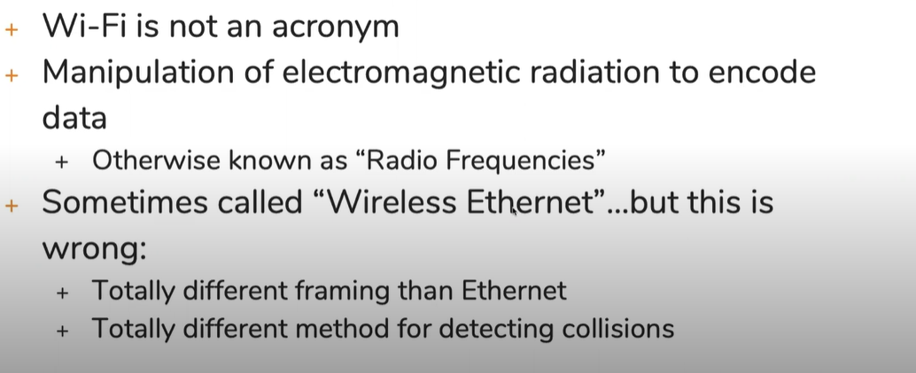
Working With Wi-Fi
What is Wi-fi
It is the manipulation of electromagnetic radiation to encode the data
it is known as radio frequencies. There is huge spectrum of the electromagnetic waves

Slide 3
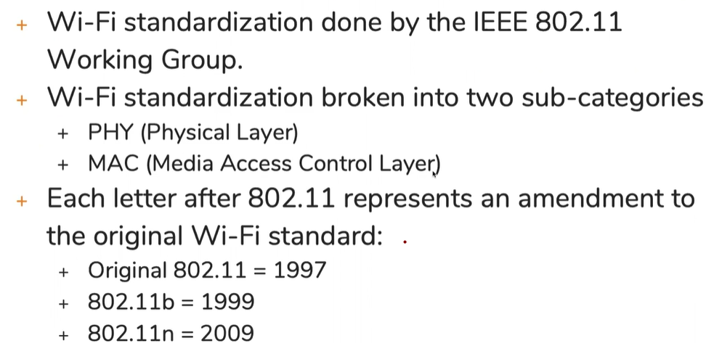
Wi-fi standardization
Physical layer: how can increase the range of wi-fi. How can we encode more data using different methods
Mac layer: how can we secure the data

Slide 4
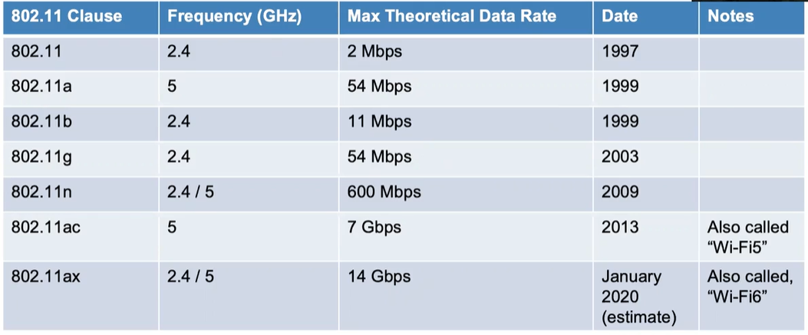
80.11 Phy standards
Frequency is just a general measurement term for measuring how often something changes over time. The unit of measurement of frequency is Hz. 1 Hz means something changing 1 time per sec.

Slide 6
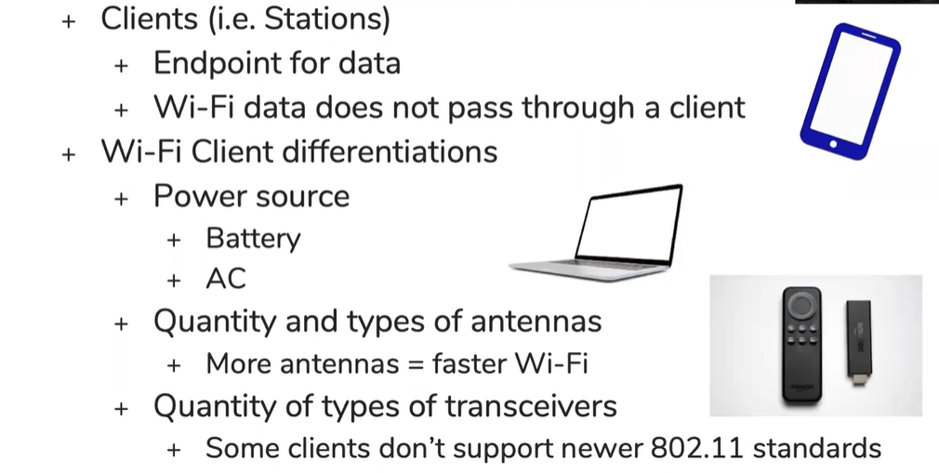
Wi-Fi Components
High power source longer we can send signals
More number of Antennas helps us to receive traffic smoothly. Antennas will convert the electrical signals into electromagnetic waves.
Transceiver is the combination of transmitter and receiver

Slide 7
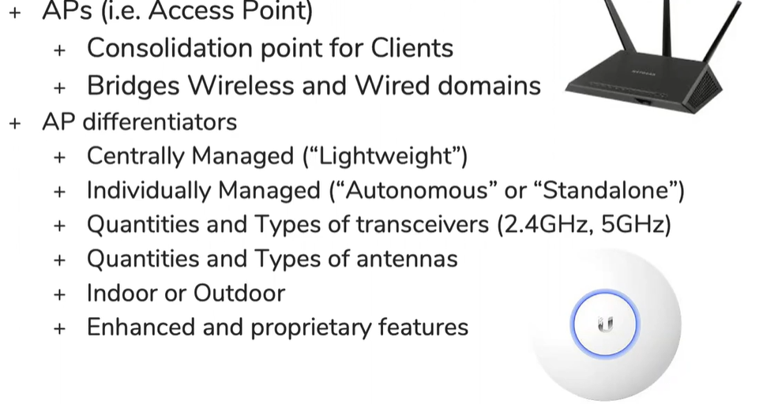
Access-Points

Slide 8
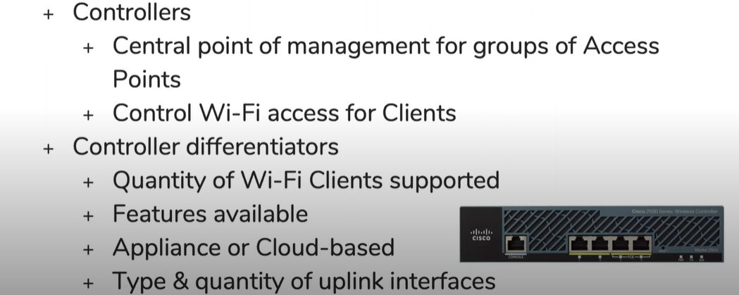
Wi-fi Controller
Everything is managed by controller. The client access to the wi-fi i.e. authentication is also done by the clontroller

Slide 9
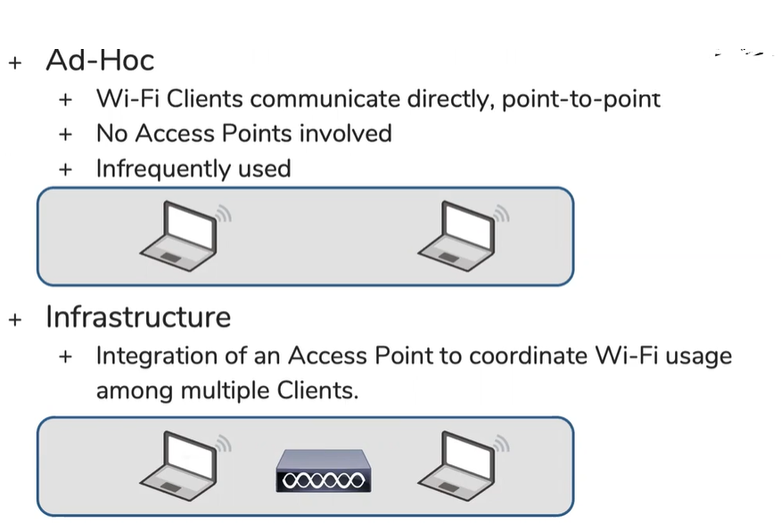
Wi-Fi Network Types & Terminology

Slide 10
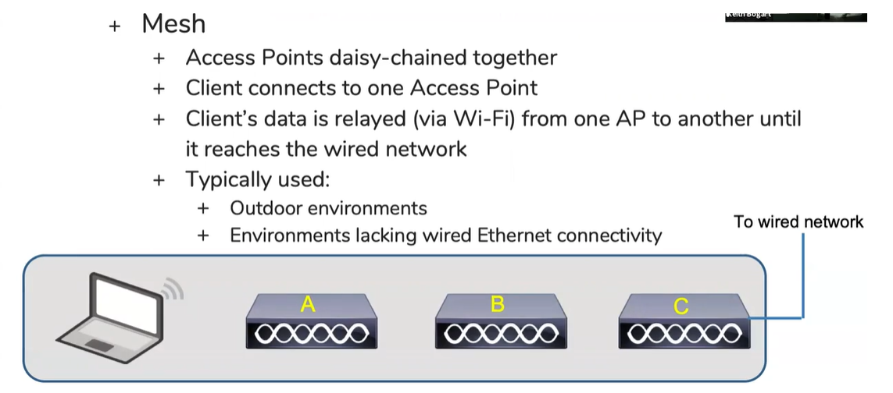
Types of wi-fi network
Mesh: AP connected to each other on wireless. Like the situation in park if one AP doesn’t connect to the wired environment it will send data to the other AP on wireless.
AP connected to the wired network is known as the RAP(root AP) and Aps in mesh is known as MAP(mesh AP)

Slide 11
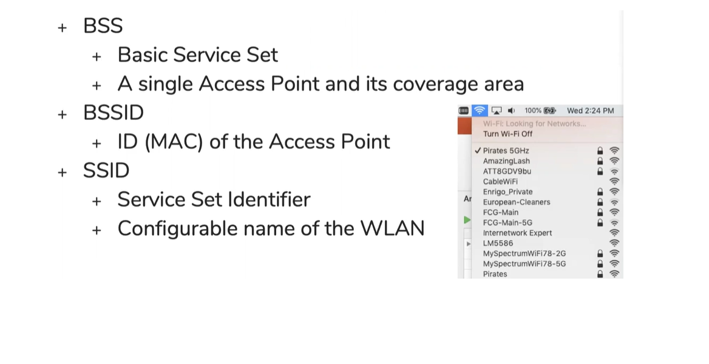
General Wi-fi terms
BSS- the area up to which the AP signals can cover
Beacon --- it is sent by the AP to tell the client about its existance. Beacons are sent 10 times per sec. Inside the beacons the MAC address will be there of AP.
BSSID- the MAC address of the AP is called BSSID

Slide 12
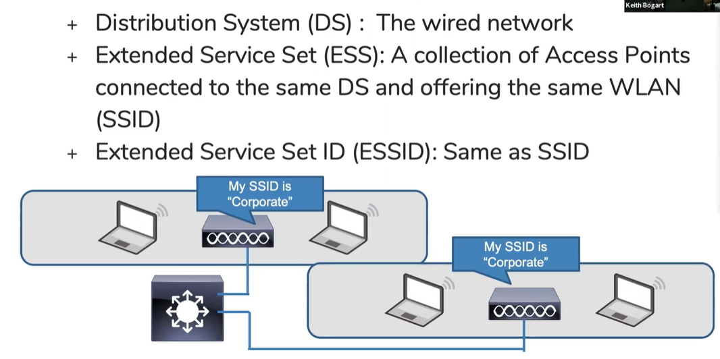
General Wi-Fi terms

Slide 14
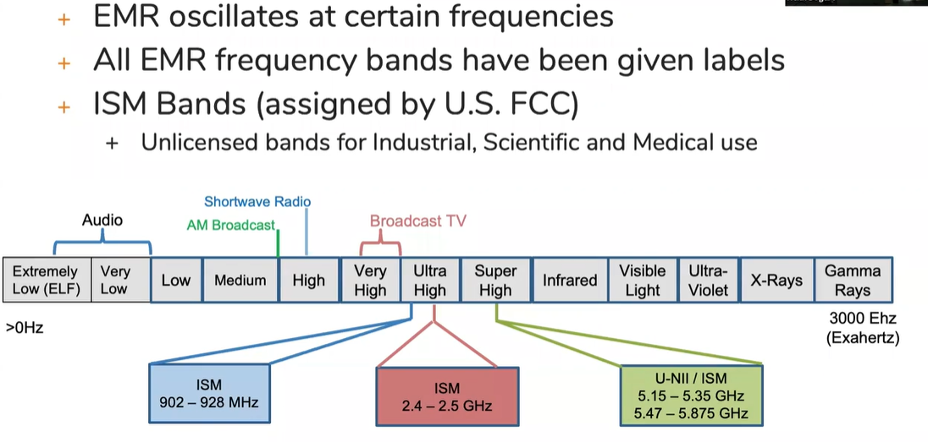
Wi-Fi Bands and Channels
ISM bands: ( industrial scientific and medical)
We know that wifi deals with radio frequencies and radio frequencies are he small subset of the large electromagnetic spectrum. By its nature EMR oscillates at certain frequencies.
All EMR which are oscillating is given certain name or label
Certain frequencies are allocated for certain purposes. So certain frequencies which are oscillating at certain rates you have to pay for them if you want to transmit on those frequencies . Some of the frequencies are there for free public use. These are called ISM band

Slide 15
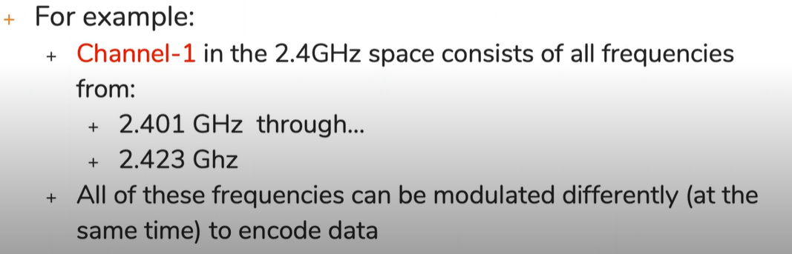
What is a Wi-fi channel
Channel is the collection of different frequencies working together

Slide 16
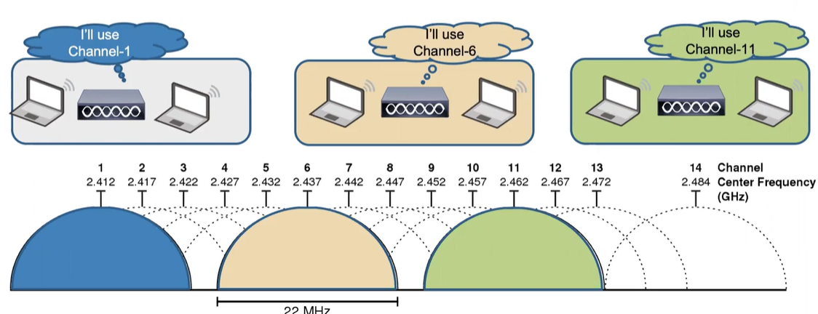
Non overlapping channel
In an environment with multiple BSS, channels must be selected that don’t overlap

Slide 17
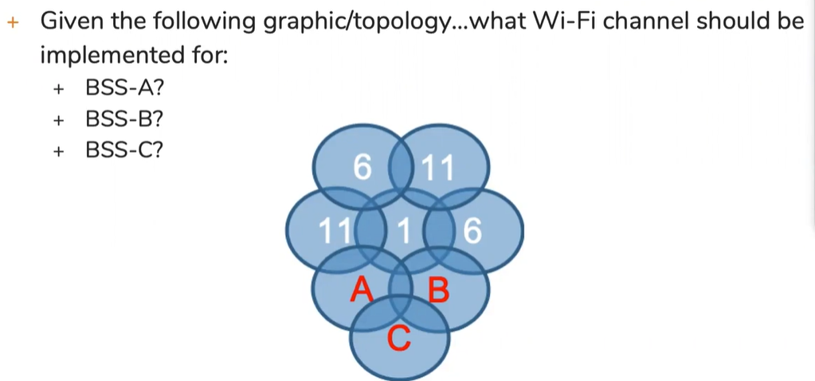
Wi-fi channel design

Slide 19
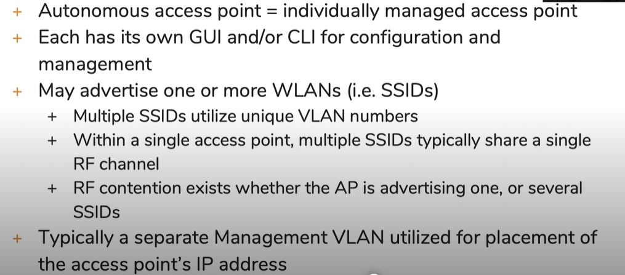
WLAN Architectures & Controllers
Autonomous WLAN Architectures

Slide 20
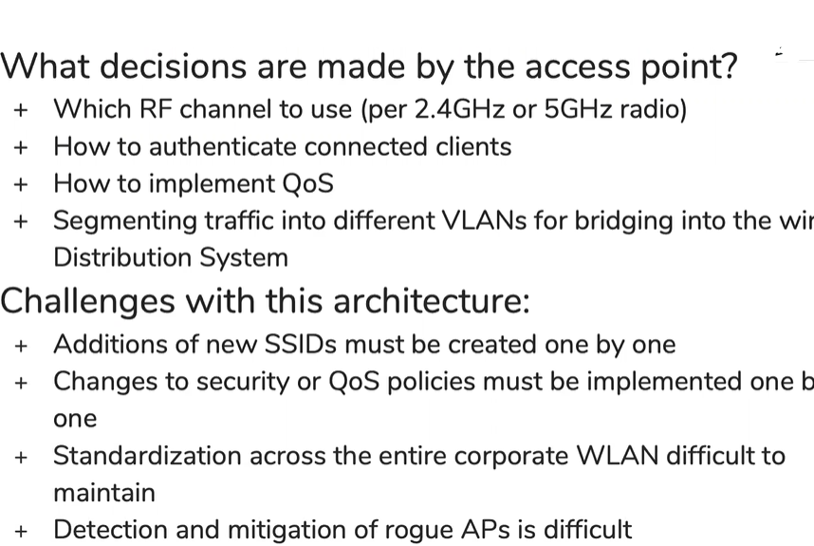
Autonomous decision and challenges

Slide 21
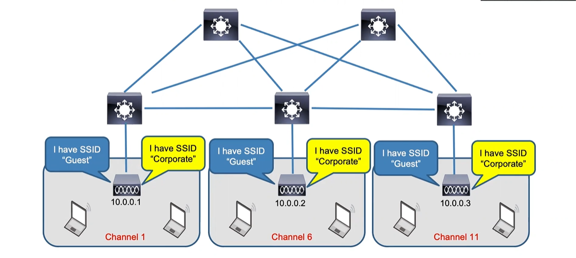
Autonomous Architecture

Slide 23
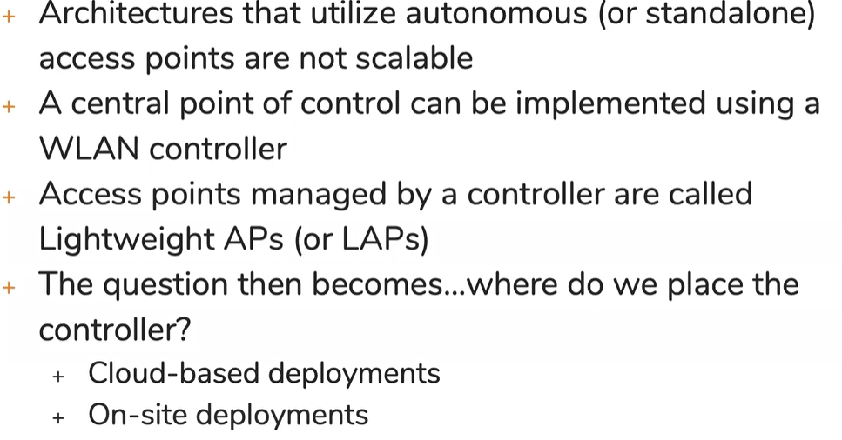
Split MAC WLAN Architectures

Slide 24
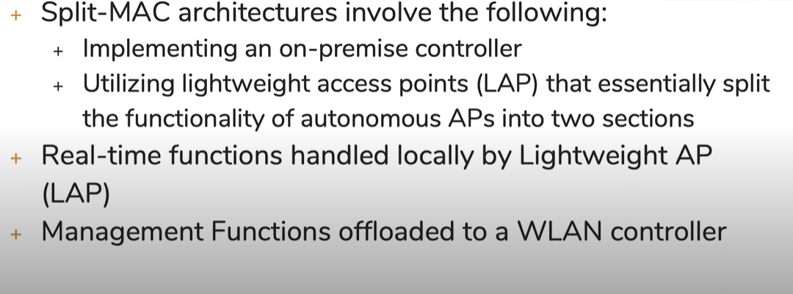
Split MAC WLAN Architectures
The real time function means the physical layer functions, it is going to deal with the radio frequencies, encryptions, collision etc.

Slide 25
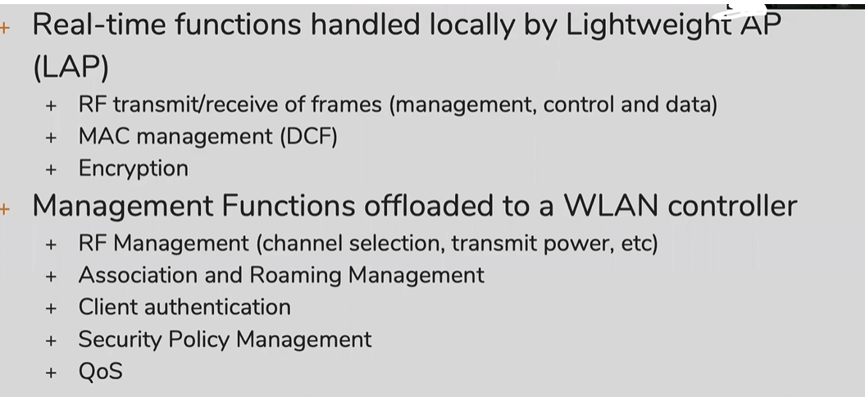
What is split?

Slide 26
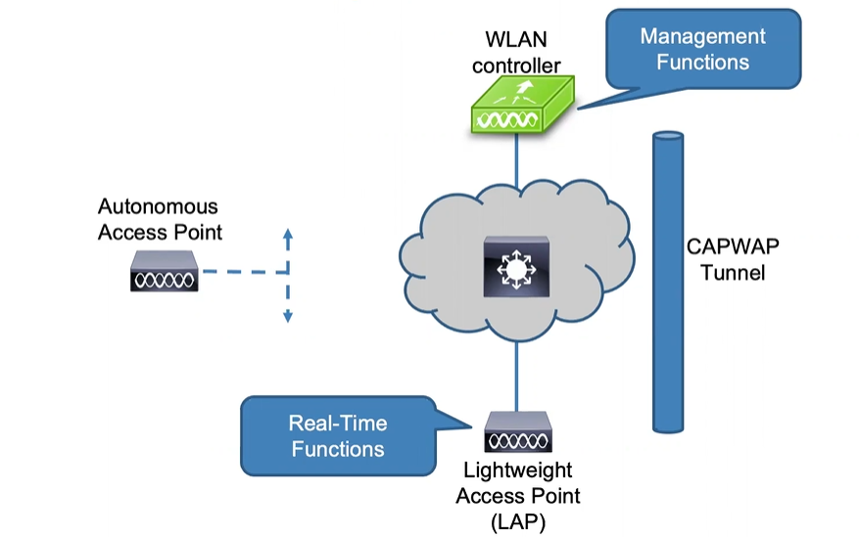
Split mac architecture

Slide 27
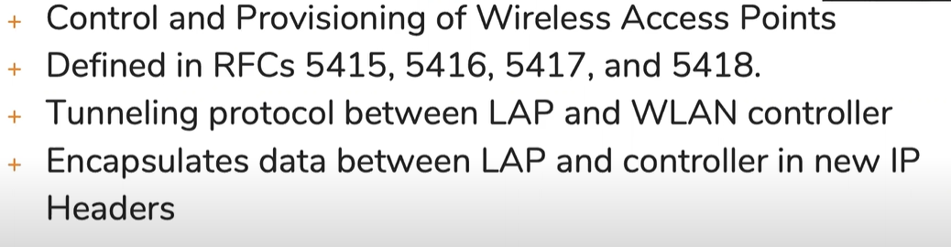
CAPWAP

Slide 28
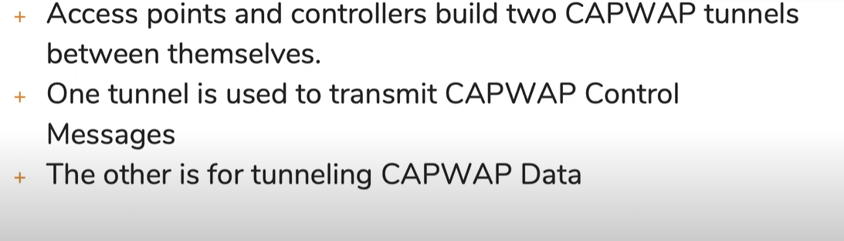
CAPWAP tunnels

Slide 29
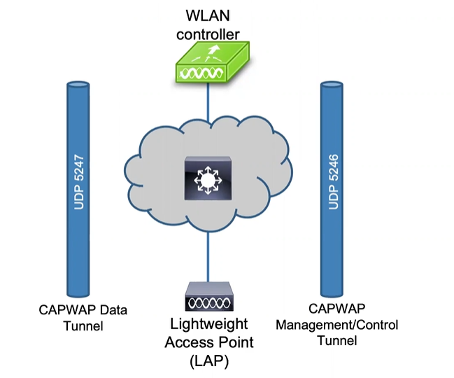
CAPWAP tunnels

Slide 30
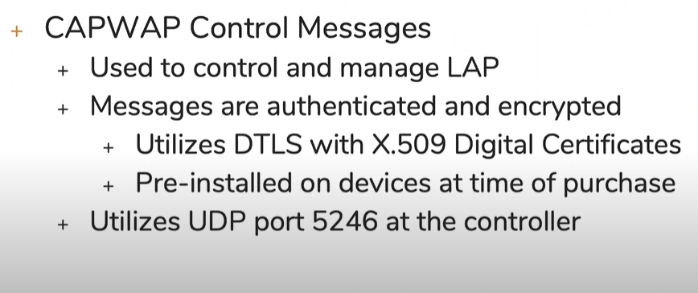
CAPWAP tunnels for control

Slide 31
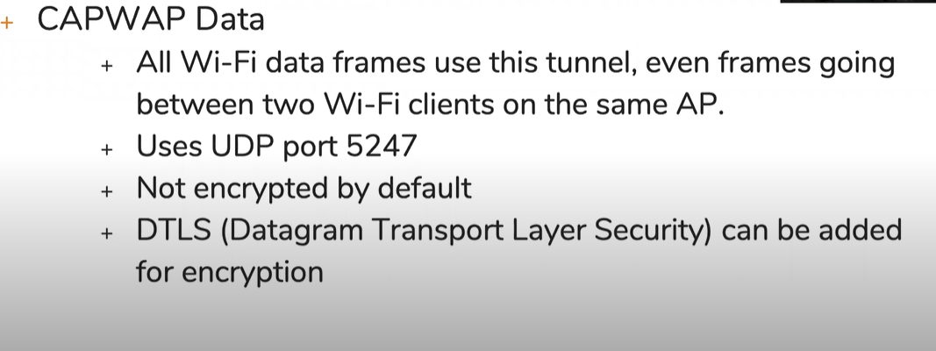
CAPWAP tunnel for data

Slide 32
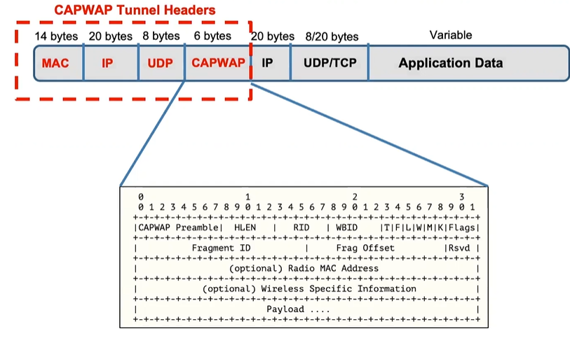
CAPWAP tunnel packet format

Slide 34
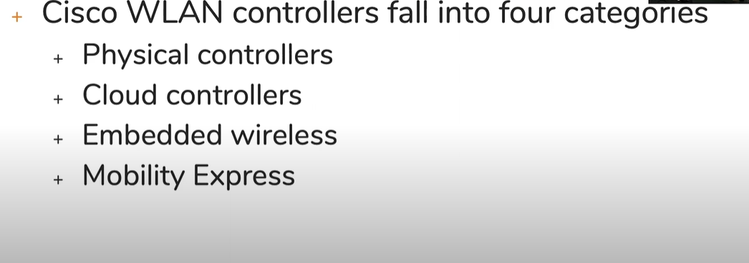
Cisco WLAN Controllers
Categories of WLAN controllers

Slide 35
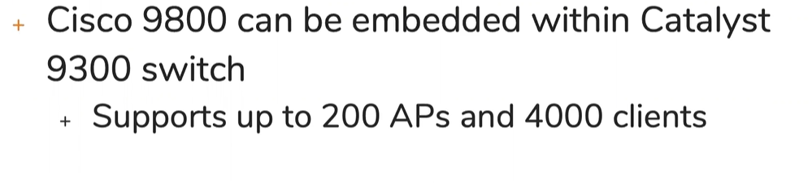
Embedded Wireless
WLAN functionality is embedded within another network device(typically a switch)

Slide 36
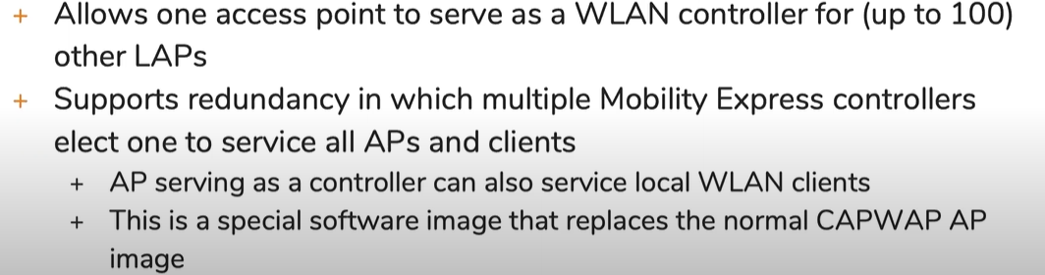
Cisco Mobility Express
WLAN controller functionality is built into certain models of cisco access points

Slide 37
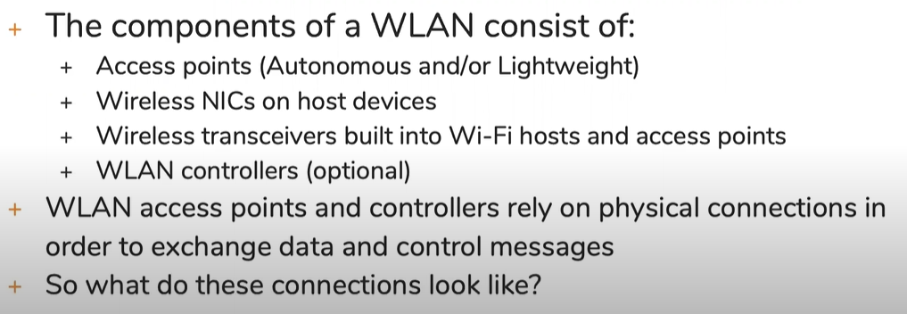
Infrastructure Connections Of WLAN Components
Connections of WLAN components

Slide 38
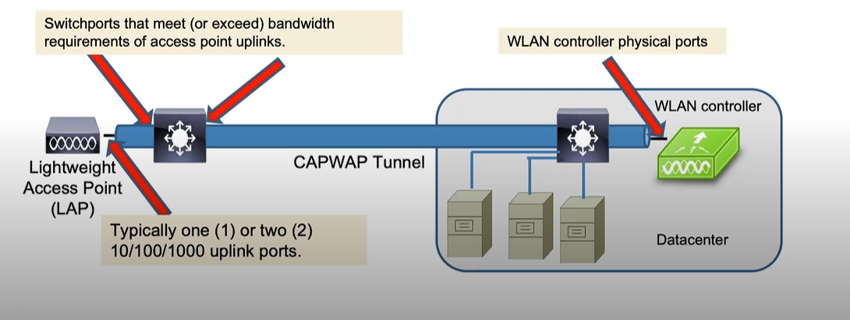
Wireless Infrastructure connections

Slide 39
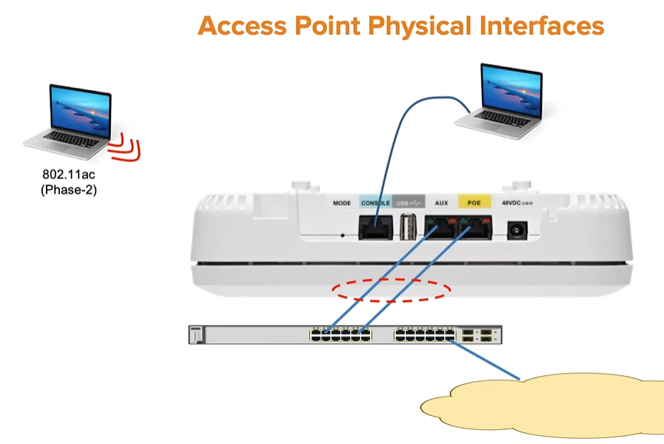
Access point physical interfaces

Slide 40
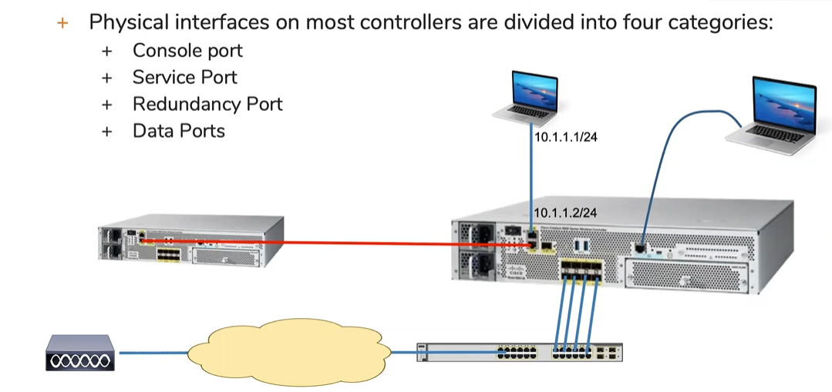
Controller Physical Interfaces

Slide 41
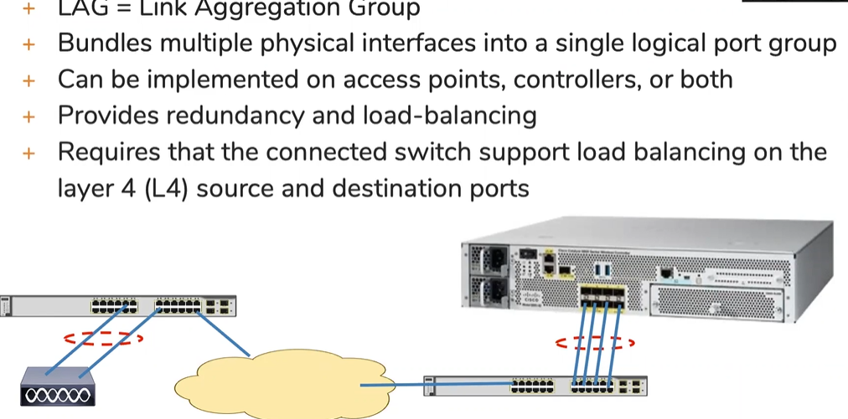
LAG

